Slide 1
Responses of organisms to the environment

Slide 2
Behaviour
Responses of organisms to signals from their internal or external environment are called behaviour.
Behaviours can be
  innate (= genetic – present at birth)
  learned (acquired during life)
  OR a mixture of the two

Slide 3
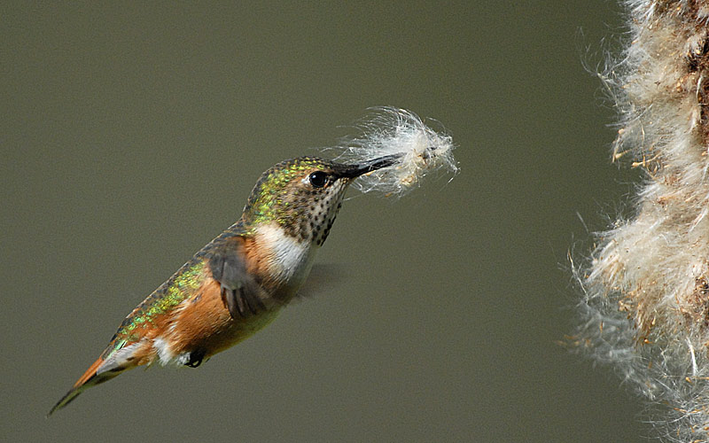
Example – nest building is innate

Slide 4
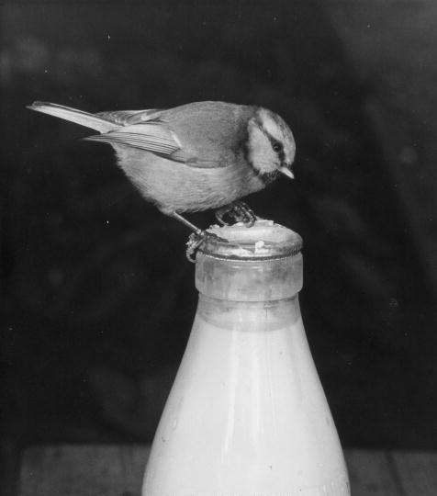
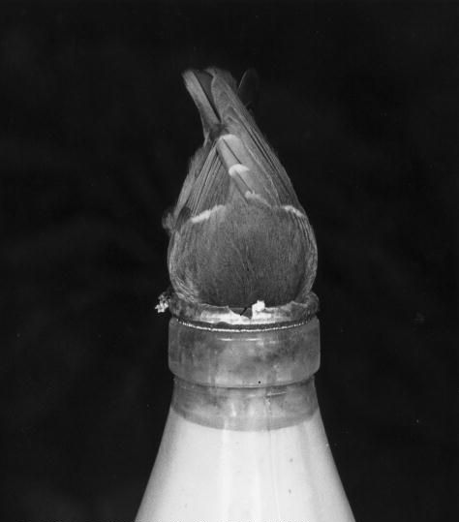
This is learned behaviour

Slide 5
Behaviour consists of:
A stimulus = change in the environment
A receptor = a cell, tissue or organ that detects the environmental changes
An effector = a cell, tissue or organ that responds to the change
Organisms often have an internal communication system and a coordination system that help them react to stimuli.

Slide 6
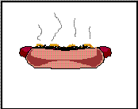
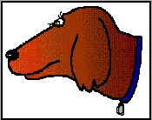

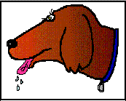
Example
Stimulus (smell)
Communication (nerves)
Coordination (brain)
Receptor (nose – olfactory cells)
Effector (salivary glands)
Communication (nerves)

Slide 7
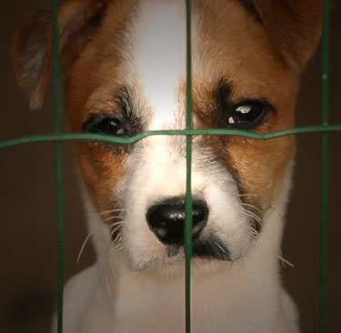
Anthropomorphism
Isn’t he sad!
Attribution of human motivation, emotions, characteristics, or behaviour to non-human things is called anthropomorphism and must be avoided.

Slide 8
The big DON’T
Don’t write that the plant or animal “likes” light, food, dark, water etc.
DO talk about “prefers” – if that is what your experiment really showed
  E.g. the ants preferred sugar over nutrisweet.

Slide 9
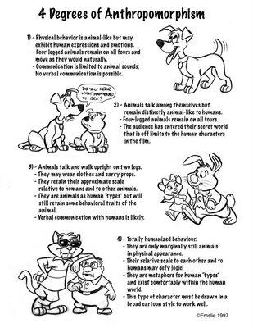
Anthropomorphism is rampant in comics and animated cartoons

Slide 10
Adaptations
The ecological niche is a description of
Opportunities provided by the habitat
The organism’s adaptations to exploit these opportunities

Slide 11
4 Types of Adaptations
Structural
  colour, shape, appendages, organ
Behavioural
  Innate responses to the environment
Physiological (functional)
  To do with organism’s metabolism (internal reactions) e.g. muscle contractions, secretions
Life History
  E.g. insect lifecycle.

Slide 12
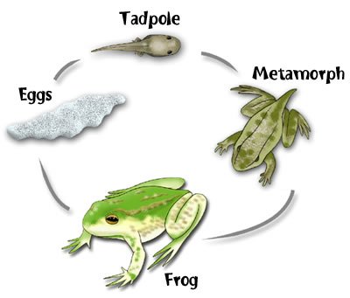
What adaptations are these
This is a life history adaptation

Slide 13
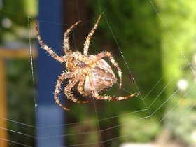
Structural adaptation
Silk gland
Making Silk in the gland
Physiological adaptation
Building web
Behavioural adaptation

Slide 14
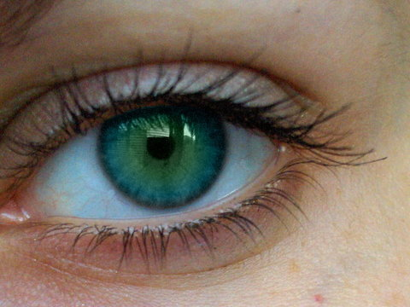
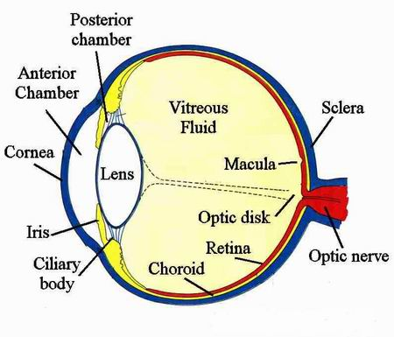
Eye
Structural adaptation
Sending a signal to the brain
Physiological adaptation

Slide 15
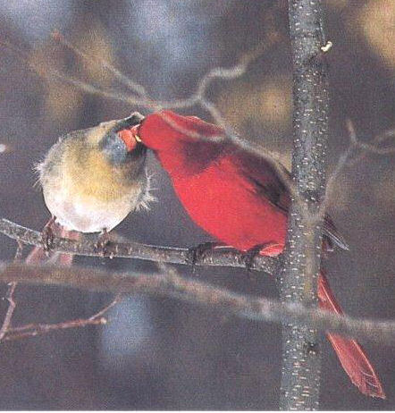
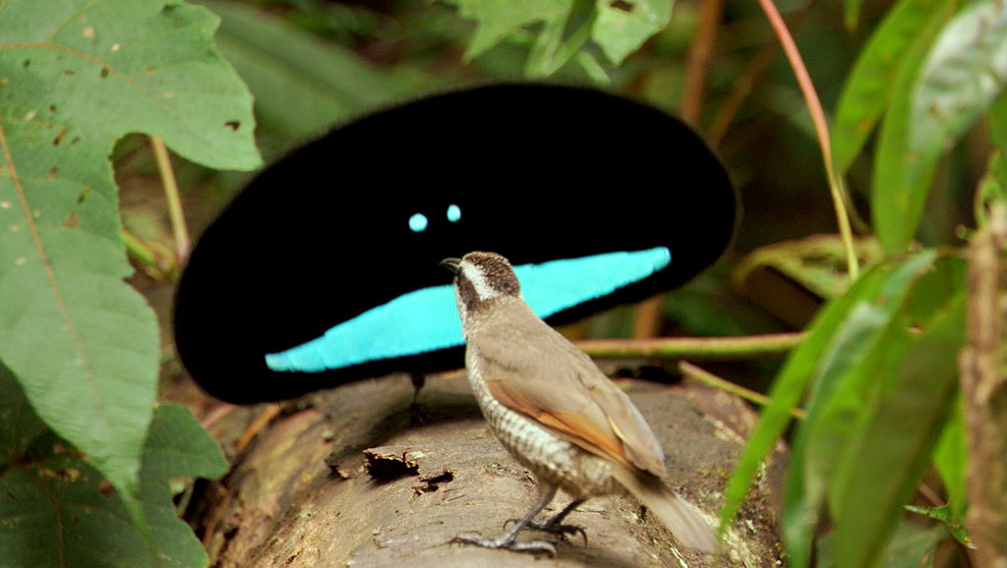
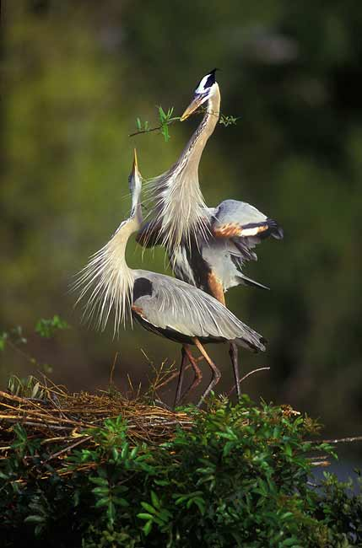
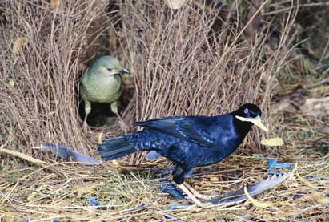
Bird courtship
Behavioural adaptations

Slide 16
The End

